Slide 1


Project 1.5
Linear Regression

Slide 2


Ski Resort Data
Background
Data Description
Cleaning and Null Values
Data Visualisation
Model Fitting
Results

Slide 3
Background
Aim: Use details of ski resorts from all over the world to produce a model for predicting the cost of a ski pass.
Use Cases:
Set resort prices based on competition
Determine if a resort is good value or not
Target: ±5 Euros to be useful

Slide 4
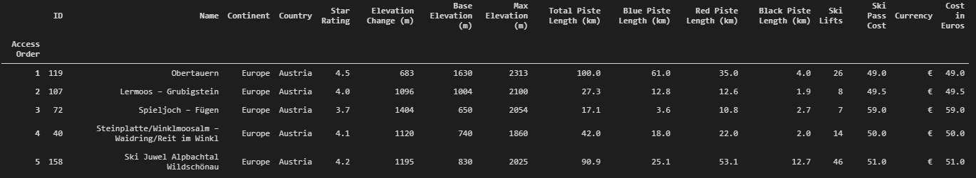
Data Description
16 different features for each resort
Cost of ski pass in common currency (Euros) is available for every resort

Slide 5
Data Description

Slide 6
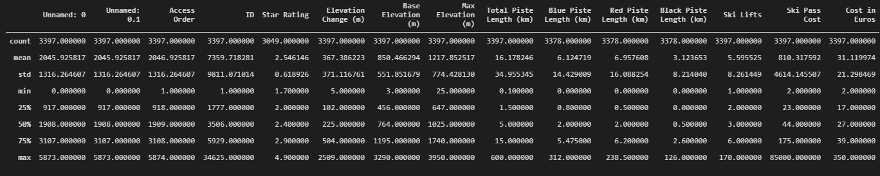
Cleaning and Null Values
Looked at some key statistics to identify issues

Slide 7
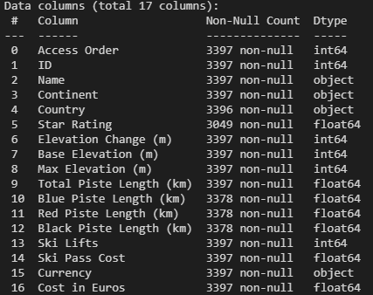
Cleaning and Null Values
Null values in Country, Breakdown of Piste Lengths and Star Rating

Slide 8
Cleaning and Null Values
Some funny cost values were identified
Looking at the websites there was an error
The Norwegian resort was in Kroner not Euro, this was fixed
The UK dry slope had a complicate cost breakdown, £121 was wrong so it was dropped

Slide 9
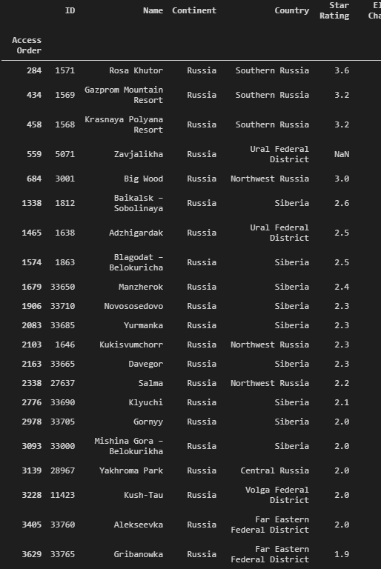
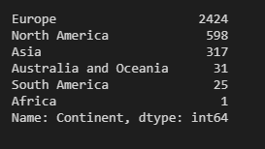
Cleaning and Null Values
Russian resorts were captured incorrectly
Continent was set to “Russia”, with the location incorrectly set as the country.
All instances of Russia in the Continent column were replaced with Europe
The equivalent Country was set to Russia

Slide 10
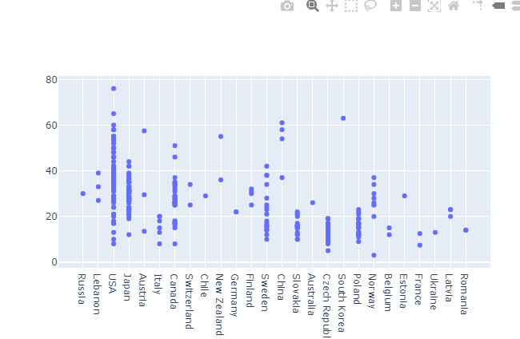
Changing and Null Values
10% of Star Rating values are missing

Slide 11
Changing and Null Values
Looked at these on a Country basis
Dropped countries (Lebanon and Latvia) with over 50% of values missing
For the rest, replaced the null value with the mean rating for that country

Slide 12
Changing and Null Values
Some piste length breakdowns missing
Relied on experience to fill
Set blue and black piste lengths to 0
Set red piste lengths equal to total piste length

Slide 13
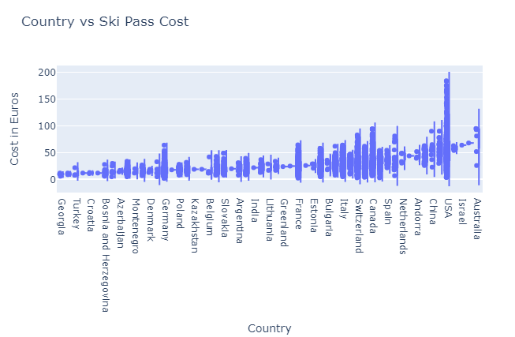
Data Visualisation

Slide 14
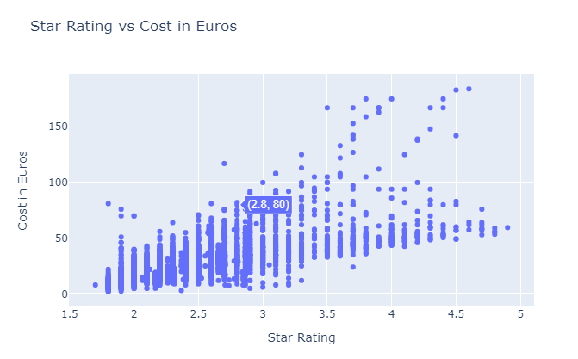
Data Visualisation

Slide 15
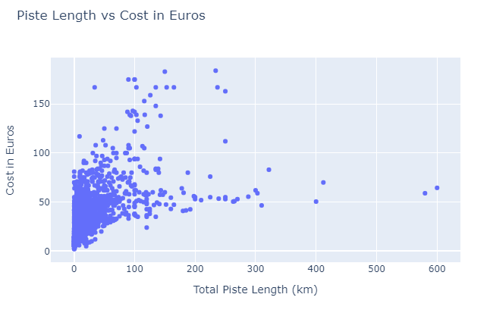
Data Visualisation

Slide 16
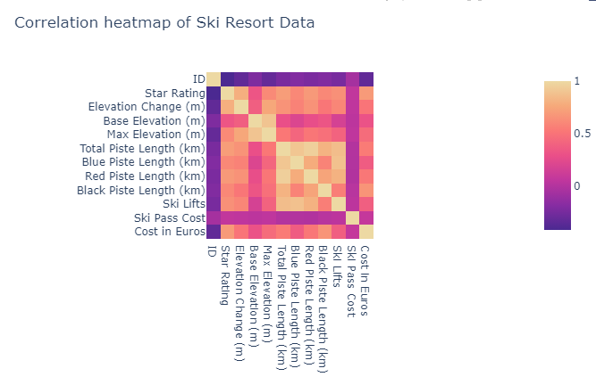
Data Visualisation
Ski lifts and piste length correlated as anticipated
Star Rating, Elevation Change and Piste Length are most strongly correlated

Slide 17
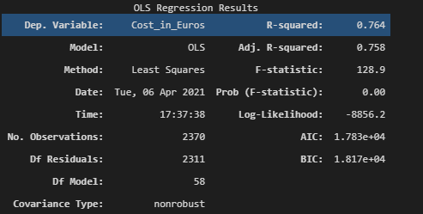
Model Fitting
Used ols from statsmodels
Two categorical columns: Continent and Country
Get a good initial Rsquared value

Slide 18
Model Fitting
Used ols from statsmodels
Two categorical columns: Continent and Country
Get a good initial Rsquared value

Slide 19

Model Fitting
Used ANOVA1 to confirm the Country variable was important
No need for ANOVA2

Slide 20
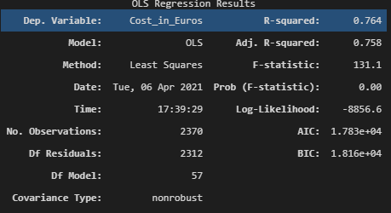
Model Fitting
The number of ski lifts was removed since the p-value was above 0.05
Makes no difference, confirming decision

Slide 21
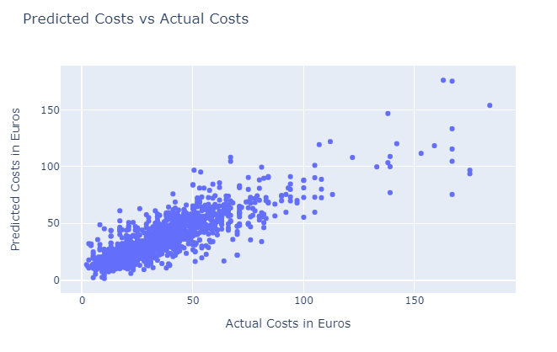
Results

Slide 22
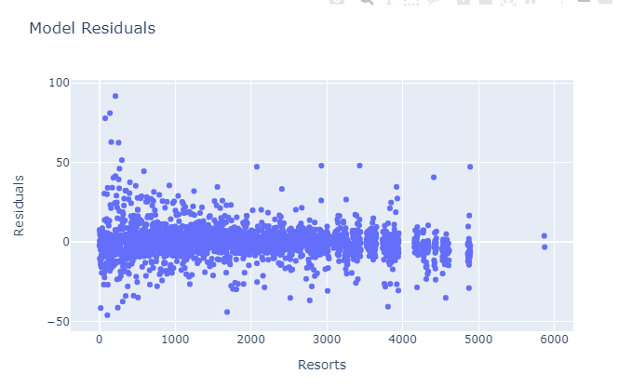
Results
No obvious trend in the residuals
Results are far off target in most cases:
RMSE of c.10 Euro

Slide 23
Results
Unable to do a train/test split
Not all countries captured in the split
Possibly creating an “Other” category in countries resolves this

